Slide 1
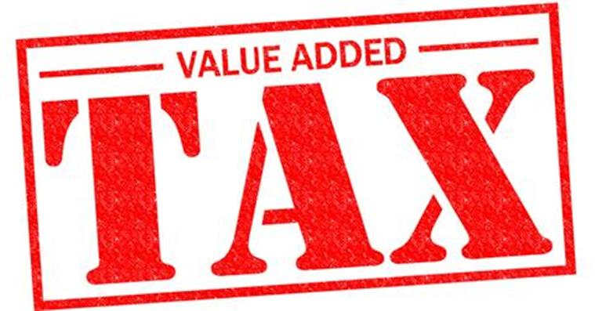
Value added tax

Slide 2
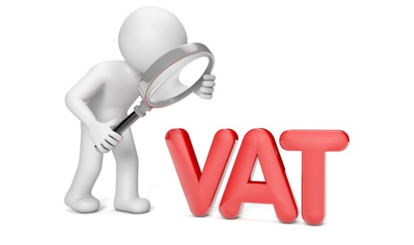
VAT Act
VAT Act is dealt with in Tax 298 and 399
Connection to Fin Acc?
VAT is integral to the accounting system of any business which is registered for VAT
VAT can be tested in conjunction with any topic where transactions occur
Test questions will usually indicate whether VAT is applicable or should be ignored.
Where VAT is applicable in a test question:
Assume prices include VAT, unless otherwise indicated in the question

Slide 3
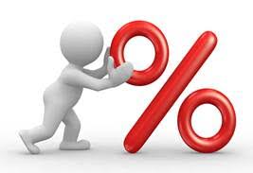
VAT: how it is levied
Older questions still use 14%.
Newer questions use 15%.
Assessments will use 15%.
14% (until 31 March 2018)
15% (from 1 April 2018)
of all goods and services supplied by vendors
VAT vendor
Person (company, CC, individual etc.)
Registered for VAT
Compulsory –enterprises with turnover > R1 000 000
Voluntary – enterprises with turnover > R50 000
NB: definition of enterprise
Exemptions/deemed supplies
Dealt with in Tax 399

Slide 4
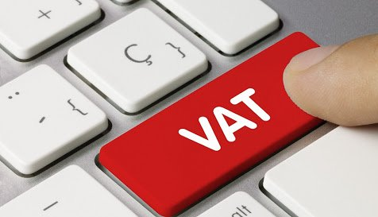
VAT: mechanics
Output tax on sales
Input tax on purchases
Difference between output and input VAT
= amount payable to SARS or receivable from SARS
NB! VAT is not another tax on enterprises – enterprises merely act as collection agents for SARS

Slide 5
VAT: mechanics
VAT is levied at each point in the production and distribution channel
Example 1 and 2

Slide 6
VAT: Accounting treatment
All subsidiary journals have a VAT column (example)
Levy VAT on all sales and services rendered
VAT is NOT raised on the receipt of cash
Pay VAT on all purchases and services used
VAT is NOT raised on payment of CASH
Trade discount
Sales and purchase returns
Release of rights
Cash discount received/allowed
Release of obligation to pay creditor and bad debts

Slide 7
VAT: Accounting treatment
Month-end
Debit the total of input VAT column and credit the total of output VAT column to the VAT control account
Depending on the balance on the VAT control account, either
net output VAT would be payable to SARS (credit balance); or
net input VAT would be receivable from SARS (debit balance)

Slide 8
VAT: where does VAT apply?
Purchases of goods and services
Claim input VAT back from SARS (on the VAT levied on the purchase price by the VAT Vendor)
Adjust input VAT claim for:
Purchase returns
Cash discount with the settlement of the goods/services purchased
Release of payment by creditor (forgiveness of debt)
Sale of goods and services
Levy VAT and pay output VAT to SARS
Adjust output VAT for:
Sales returns
Cash discount with the receipt of payment for goods or services rendered
Bad debts written off

